Slide 1
APARTMENT SHINY
Cheese Slicer ChopstiCKs

Slide 2
Table of Contents
Motivation
Objective
Data
Prediction Model
Shiny App Demonstration
Q&A
Credit
Reference

Slide 3

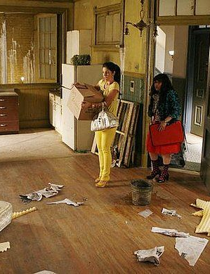
MOTIVATION
Information asymmetry between students and apartments
Variations in the number of reviews of apartments on websites

Slide 4

objective
Predict rankings of apartments close to Duke campus by applying bayesian statistical method

Slide 5
DATA
Challenges
Ban on Web Scraping
Ban on Mirror Creating
Solutions
httrack?
Downloading Manually!

Slide 6
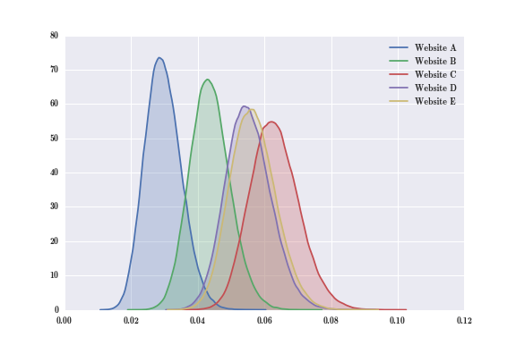
Prediction Model
Ordered Multinomial Logistic Model with Varying Intercepts (fancy!) with JAGS
More accurate scores of apartments than those on “ApartmentRatings.com”
Posterior distribution of scores for each apartments and rankings according to specification

Slide 7
Shiny app Demonstration
https://victor9496.shinyapps.io/apt_rating/

Slide 8
Q&A

Slide 9
Credit
http://shiny.rstudio.com/gallery/superzip-example.html

Slide 10
Reference
http://www.apartmentratings.com/ (Data Source)
http://www.boj.or.jp/en/research/wps_rev/wps_2016/data/wp16e17.pdf (Model Source)

